Slide 1
Cleveland Street School Parent Portal Guide
Created by Jacqueline Murphy
Edited by Darryl R. Smith, M. Ed. School Counselor

Slide 2
Go to the Cleveland St. School’s Website (https://www.orange.k12.nj.us/Domain/687) and click on Parent Information and Resources
Click Here

Slide 3
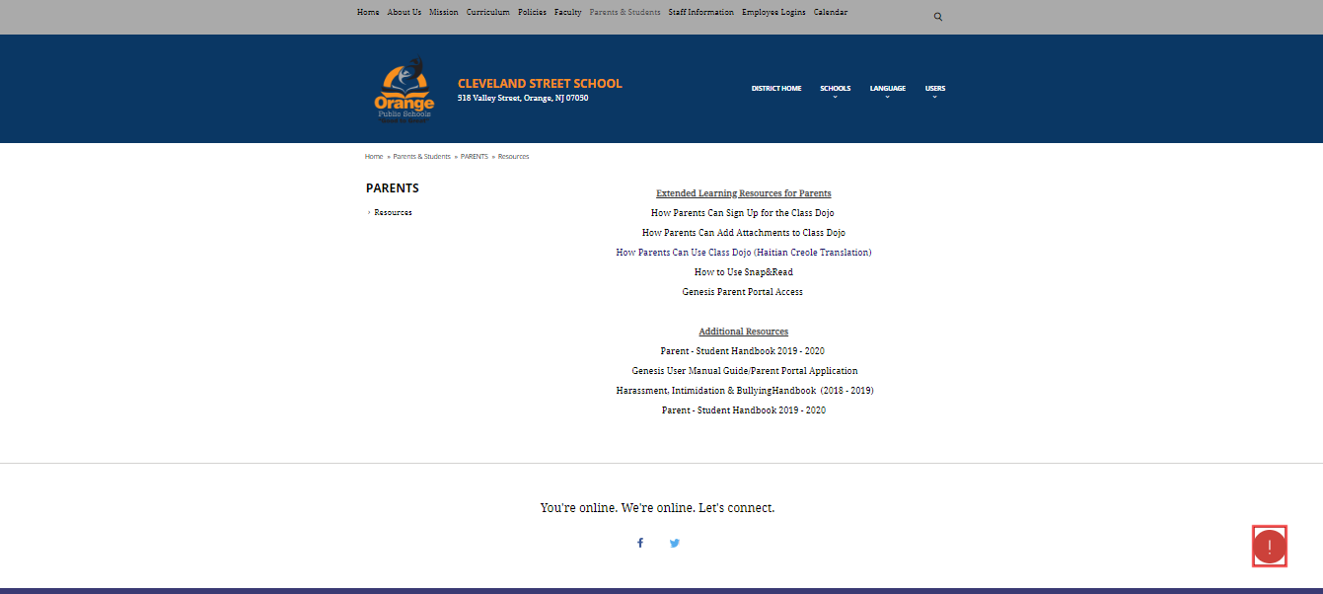
Click on Genesis Parent Portal
Click Here

Slide 4
Enter your username and password
Logging into the Parent Portal is very simple:
Enter your Email Address that was sent to you in the “Username” field.
Enter your Parent Access password in the “Password” field.
Click the “Login” button
Logging In for the First Time The very first time you login you will be required to change your password.
What if I forget my password? If you forget your password, you must click the Forgot My Password‟ link on the Login page. Your existing password will be emailed to you.

Slide 5
Switching From English to Spanish
There is a “Cambiar el idioma a espanol” button at the lower left corner of every screen. To switch to Spanish, click this button. It then changes the language of the Parent module to Spanish. The button itself changes to “Change Language to English”. Click this to return to English.

Slide 6
Student Summary Dashboard Screen
Your “HOME” Screen
When you login to Genesis Parent Access the first screen you see is Parent Access “Home”. This is the Student Dashboard screen. You will see a “dashboard‟ for every student linked to your login. Each student’s “dashboard” contains the following information:
Basic information about the student: student id, homeroom, grade, age.
If you are viewing the screen during the school day, you will also see information about the class your student is in “right now”: current class, current teacher and current room.
Your student’s schedule. The class the student is in “right now” is highlighted in green. You can click on the PDF icon to print the schedule

Slide 7
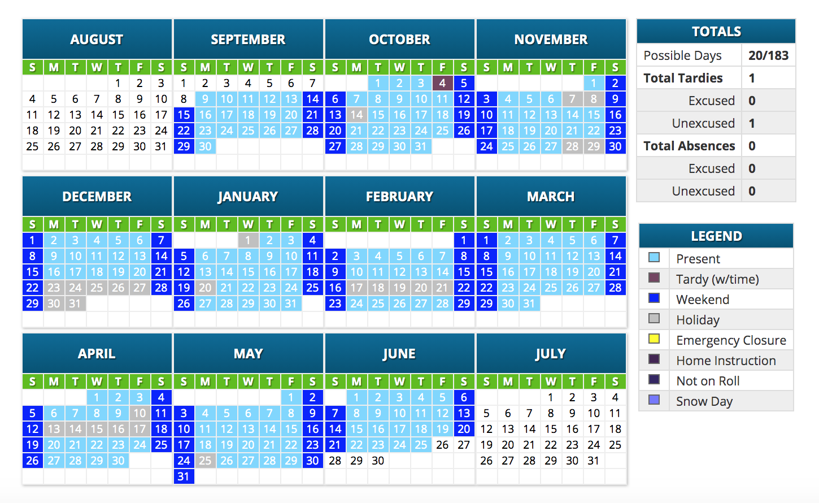
Attendance Daily Attendance
This is your student’s Daily and Class Attendance summary for the whole school year.
The Attendance Calendar with each day color coded
A summary of the student’s Attendance for the year
The “Legend” of Attendance codes.
Attendance Color Codes

Slide 8
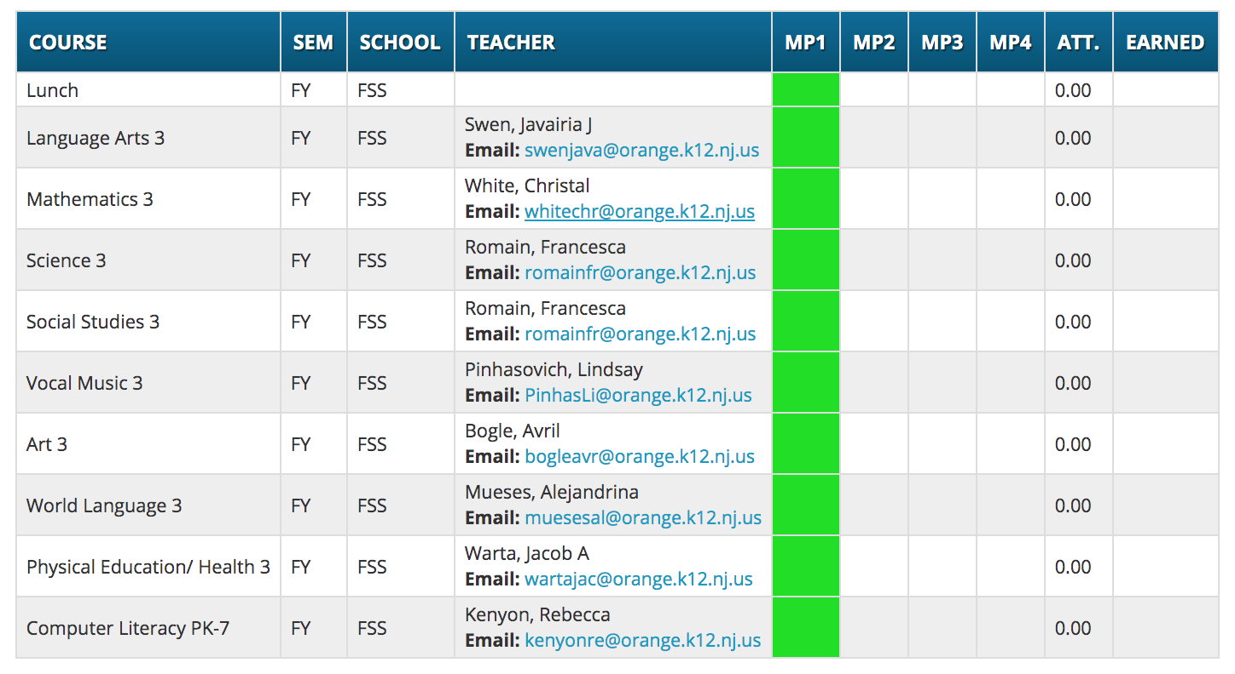
Grading
The Grading screen gives you access to your student’s Interims or Report Cards. Viewing your Child’s Most Recent Interim or Report Card If you are able to view your child’s actual report card, a “Please click here to view” message will appear between your child’s name and the form: If this message appears, click it to view the actual interim displayed in a PDF.

Slide 9
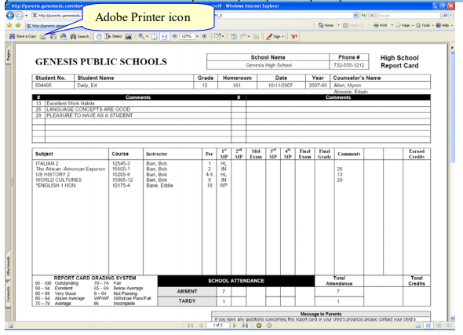
If this message appears, click it to view the actual report card displayed in Adobe Reade (Adobe Reader must be installed on your computer). A sample report card is shown below.

Slide 10
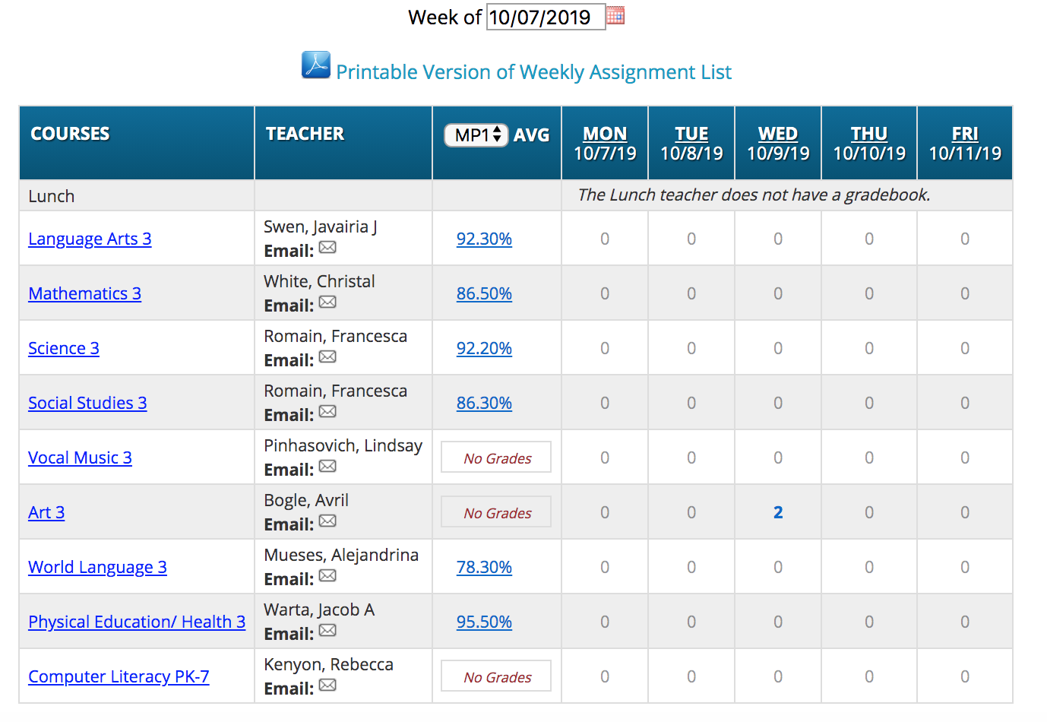
Grade Book
A list of Courses with Assignments by Day of the Current Week. This screen lists all courses y - our child is currently taking.
Marking Period Averages for the Courses - The “Avg” column shows you your child’s current Marking Period average for the current or a previous Marking Period.
Viewing all Assignments for One Course - To see all of the Assignments for one course, click on the highlighted course name. That will take you to the “One Course/All Assignments” screen.
Gradebook Week Summary
This shows you a snapshot of all Assignments that are due for the selected week. You may do the following:
Select a different week by clicking in the “Week of” field.
See all the Assignments for one course by clicking on the highlighted name of a course in the list.

Slide 11
If you need further assistance with the Parent Portal, please contact:
Mr. Darryl Smith, School Counselor
Main Office Phone: 973-677-4100
Email: smithdar@orange.k12.nj.us

